Slide 1
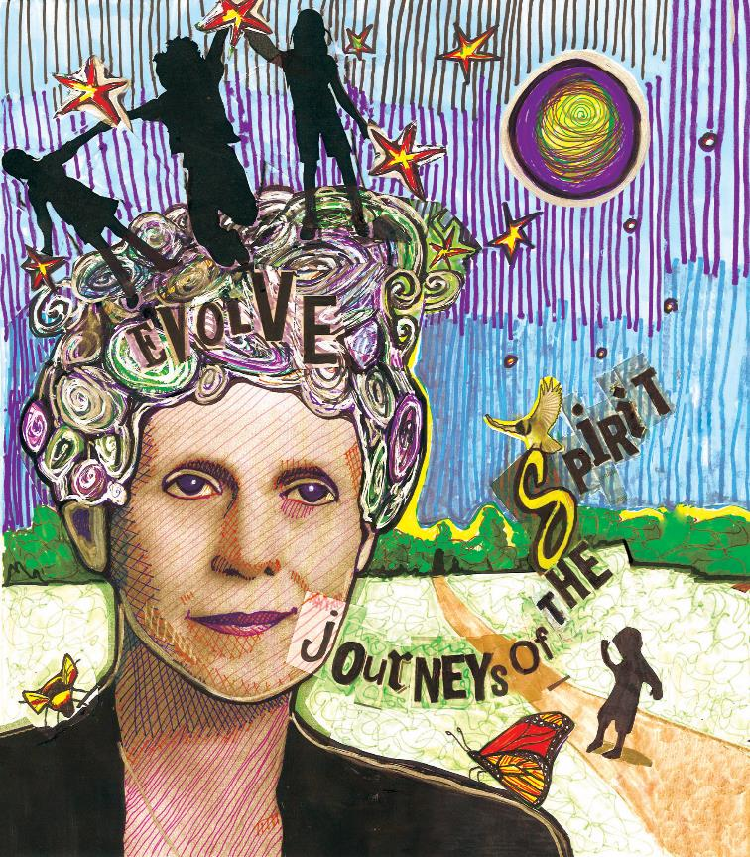
Sophia
Fahs
Sunday:
Journeys
of the Spirit
by Kaaren Anderson
Notes:
Art by Rev. Kaaren Anderson
Edit and adapt slides as necessary. Please refer to the Worship Packet Overview for notes and the Worship Script for slide transition queues.

Slide 2
Spoken Reflection Slides:

Slide 3
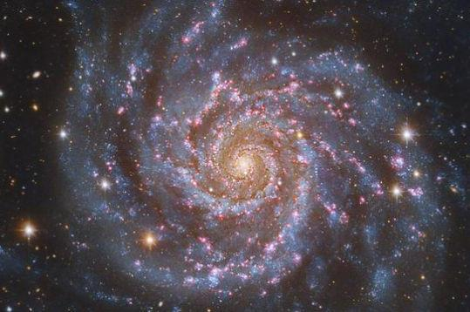
People helping us on the journey
Notes:
This slide corresponds to the Spoken Word and Music section beginning with ”We all come from many places. ..”

Slide 4
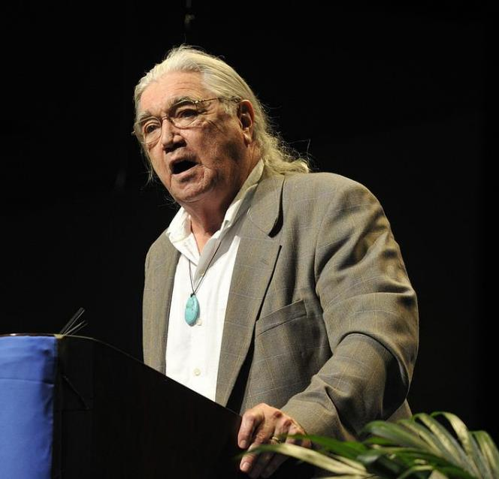
Rev.
Clyde Grubbs
Notes:
Spoken Reflection: Rev. Clyde Grubbs slide 1 of 4

Slide 5
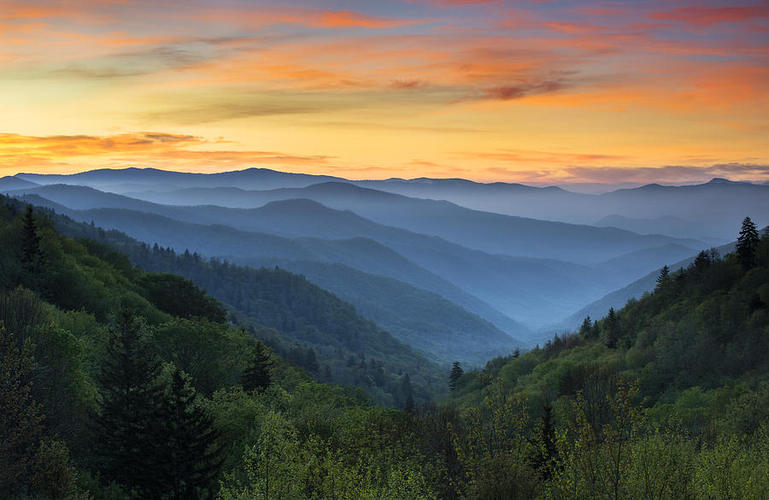
Notes:
Spoken Reflection: Rev. Clyde Grubbs slide 2 of 4

Slide 6
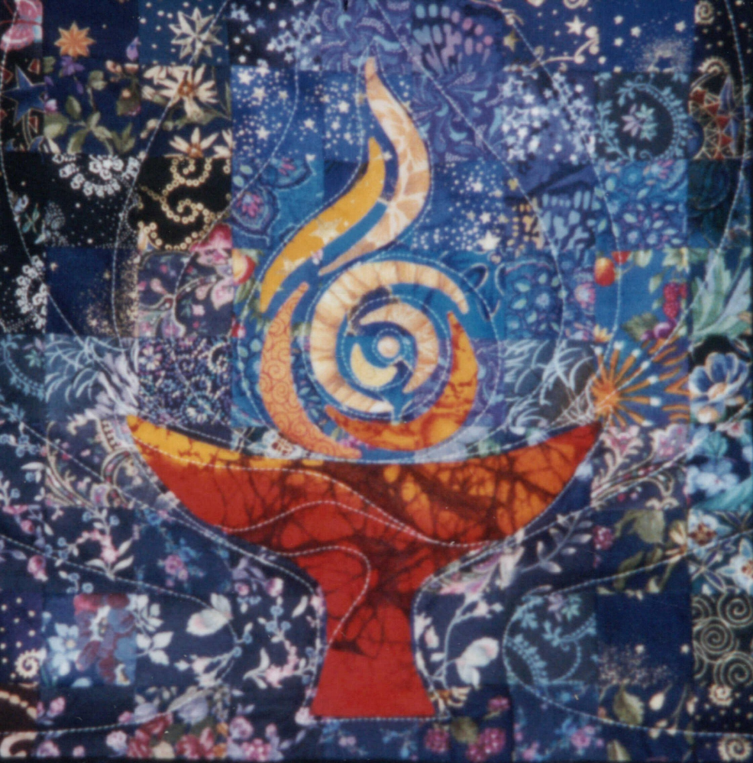
Notes:
Spoken Reflection: Rev. Clyde Grubbs slide 3 of 4
Chalice Quilt used with permission by Peg Green
http://peacepeg.tripod.com/

Slide 7
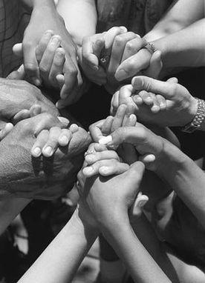
Notes:
Spoken Reflection: Rev. Clyde Grubbs slide 4 of 4

Slide 8
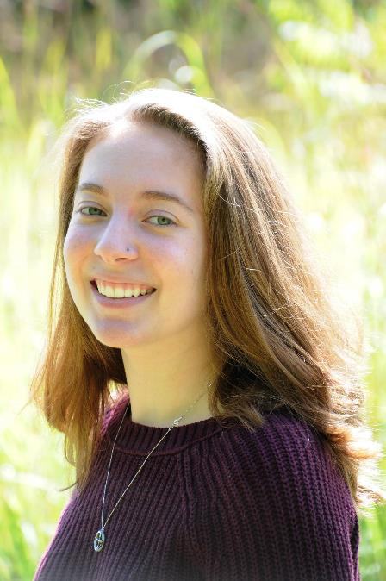
Samantha
Burden
Notes:
Spoken Reflection: Samantha Burden slide 1 of 4

Slide 9
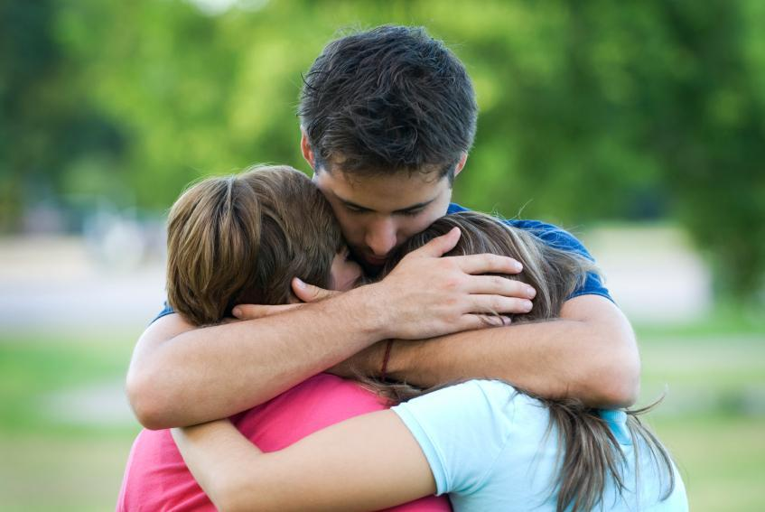
Notes:
Spoken Reflection: Samantha Burden slide 2 of 4

Slide 10
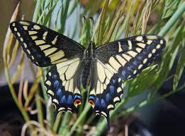
Notes:
Spoken Reflection: Samantha Burden slide 3 of 4

Slide 11
Notes:
Spoken Reflection: Samantha Burden slide 3 of 4

Slide 12
People Helping Us on the Journey
I wonder who has helped you along the way?
And I wonder how they have helped you?
Notes:
Community Response “People Helping Us on the Journey” and Chant

Slide 13
Helping Others On Their Journey
Notes:
Slide for Spoken word and music “Sometimes we feel alone…” before Wooden reflection

Slide 14
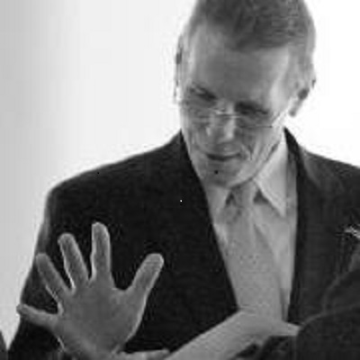
Rev.
Fred Wooden
Notes:
Spoken Reflection: Rev. Fred Wooden slide 1 of 4

Slide 15
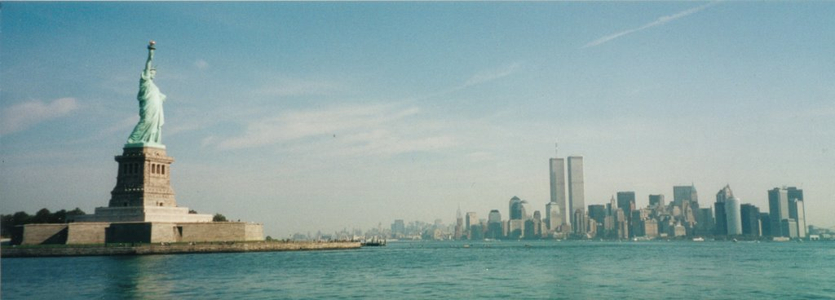
Notes:
Spoken Reflection: Rev. Fred Wooden slide 2 of 4

Slide 16
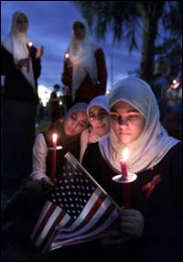
Notes:
Spoken Reflection: Rev. Fred Wooden slide 3 of 4

Slide 17
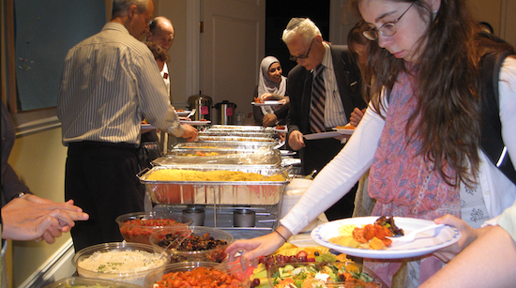
Notes:
Spoken Reflection: Rev. Fred Wooden slide 4 of 4

Slide 18
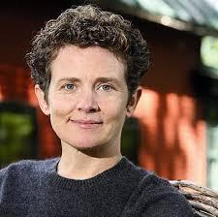
Rev.
Kate Braestrup
Notes:
Spoken Reflection: Rev. Kate Braestrup slide 1 of 4

Slide 19
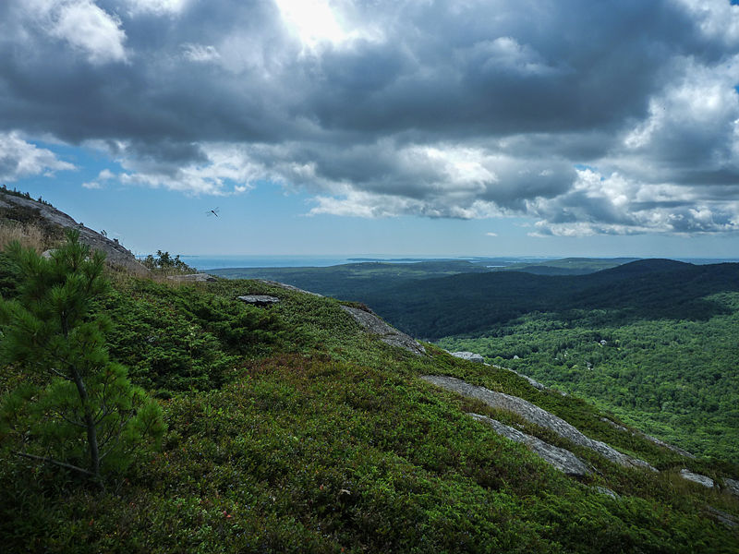
Notes:
Spoken Reflection: Rev. Kate Braestrup slide 2 of 4

Slide 20
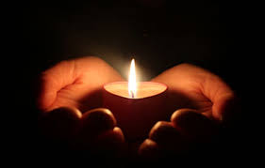
Notes:
Spoken Reflection: Rev. Kate Braestrup slide 3 of 4

Slide 21
Notes:
Spoken Reflection: Rev. Kate Braestrup slide 4 of 4

Slide 22
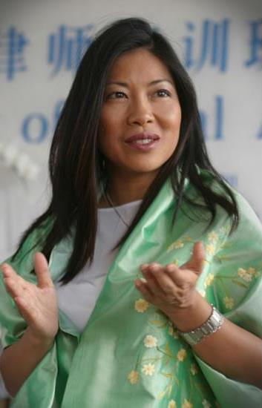
Rev.
Karen Tse
Notes:
Spoken Reflection: Rev. Karen Tse slide 1 of 4

Slide 23
Notes:
Spoken Reflection: Rev. Karen Tse slide 2 of 4

Slide 24
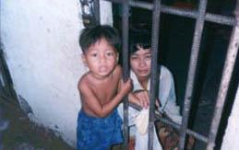
Notes:
Spoken Reflection: Rev. Karen Tse slide 3 of 4

Slide 25
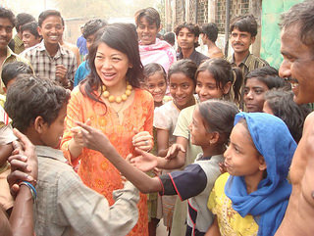
Notes:
Spoken Reflection: Rev. Karen Tse slide 4 of 4

Slide 26
Helping Others On Their Journey
I wonder if there’s ever been a time in your life when you helped someone?
I wonder if you’ve done something like this for someone you don’t know?
I wonder if someone has helped you through great sadness or difficulty?
Notes:
Community Response: Helping Others on their Journey

Slide 27
Shining Light On The Journey
Notes:
Slide for Spoken Words and Music, “Helping doesn’t always mean doing something to make a difference.” before Slack reflection.

Slide 28
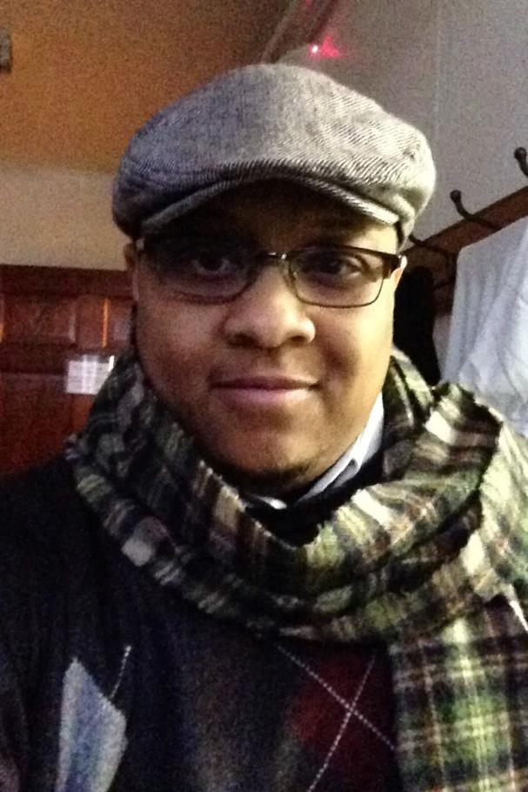
Rev.
Mykal Slack
Notes:
Spoken Reflection: Rev. Mykal Slack slide 1 of 3

Slide 29
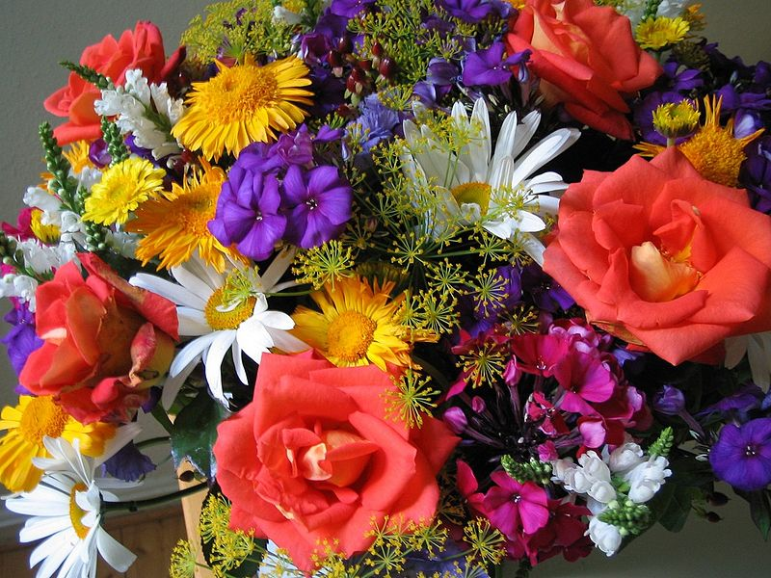
Notes:
Spoken Reflection: Rev. Mykal Slack slide 2 of 3

Slide 30
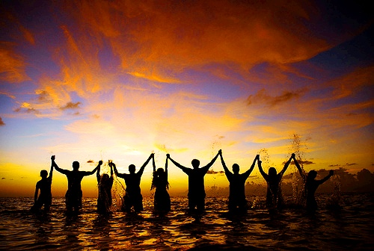
Notes:
Spoken Reflection: Rev. Mykal Slack slide 3 of 3

Slide 31
Shining Light On The Journey
I wonder if you show your true self to others?
I wonder if you feel safe sharing your true self?
I wonder if you feel safe being your true self in this community?
I wonder who your true self is?
Notes:
Community Response “Shining Light on the Journey”

